Slide 1
Supporting Our Families
At Millfields, we recognise the challenges that families face in bringing up children. There may be times when you need extra help and support. To help you and your families we have created our Early Help Offer.

Slide 2
What is Early Help?
Early help means providing support as soon as a problem appears, to stop it getting worse. This could be at any point in a child’s life from birth to the teenage years.
Anyone can provide early help you don’t need to be an expert professional. Early Help is not about passing the issue on to an expert, but thinking about the best support we can offer.

Slide 3
Who might benefit from Early Help? Please click on the tiles to find out more.
-Families who would like advice around routines and family rules
- Families who would like advice about healthy eating
- Families who would like advice around healthy sleep patterns
- Children who are caring for a family member
- Children who may not want to go to school for different reasons
- Families who are struggling financially
- Children in the family have special educational needs (SEND)
- Children who may become involved in anti-social or criminal behaviour
- Children who go missing from home
- Harmony at Home | Worcestershire County Council
- Children who are experiencing loss and bereavement
- Children who may need support because they may live in a home and see drug or alcohol abuse
-Children who have or live in a home where a family member has mental health problems.
- Children who have parents who argue a lot (and sometimes might hurt each other.)
-Families who are concerned about their child’s online behaviour
- Children at risk of being groomed to join groups which support illegal views
- A privately fostered child (a child from another family living within your family home)
Or anyone who has any worry about something that is negatively impacting on your children.

Slide 4
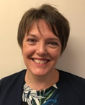
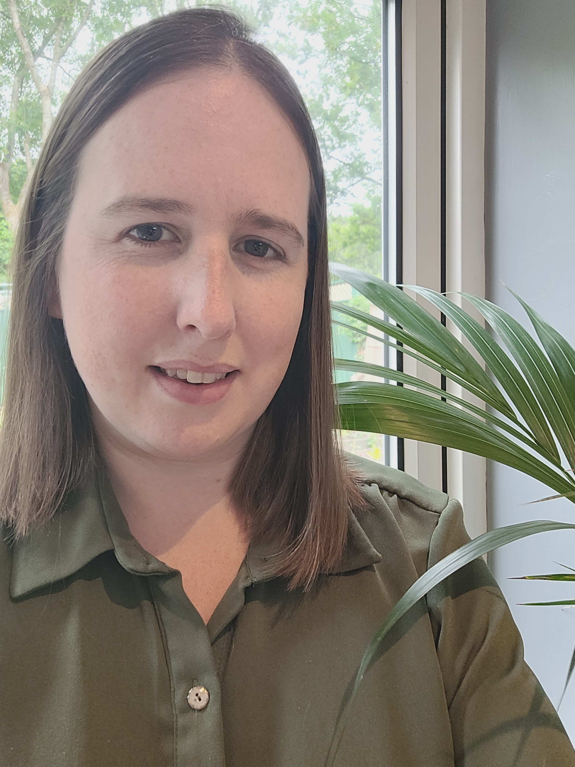
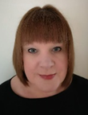
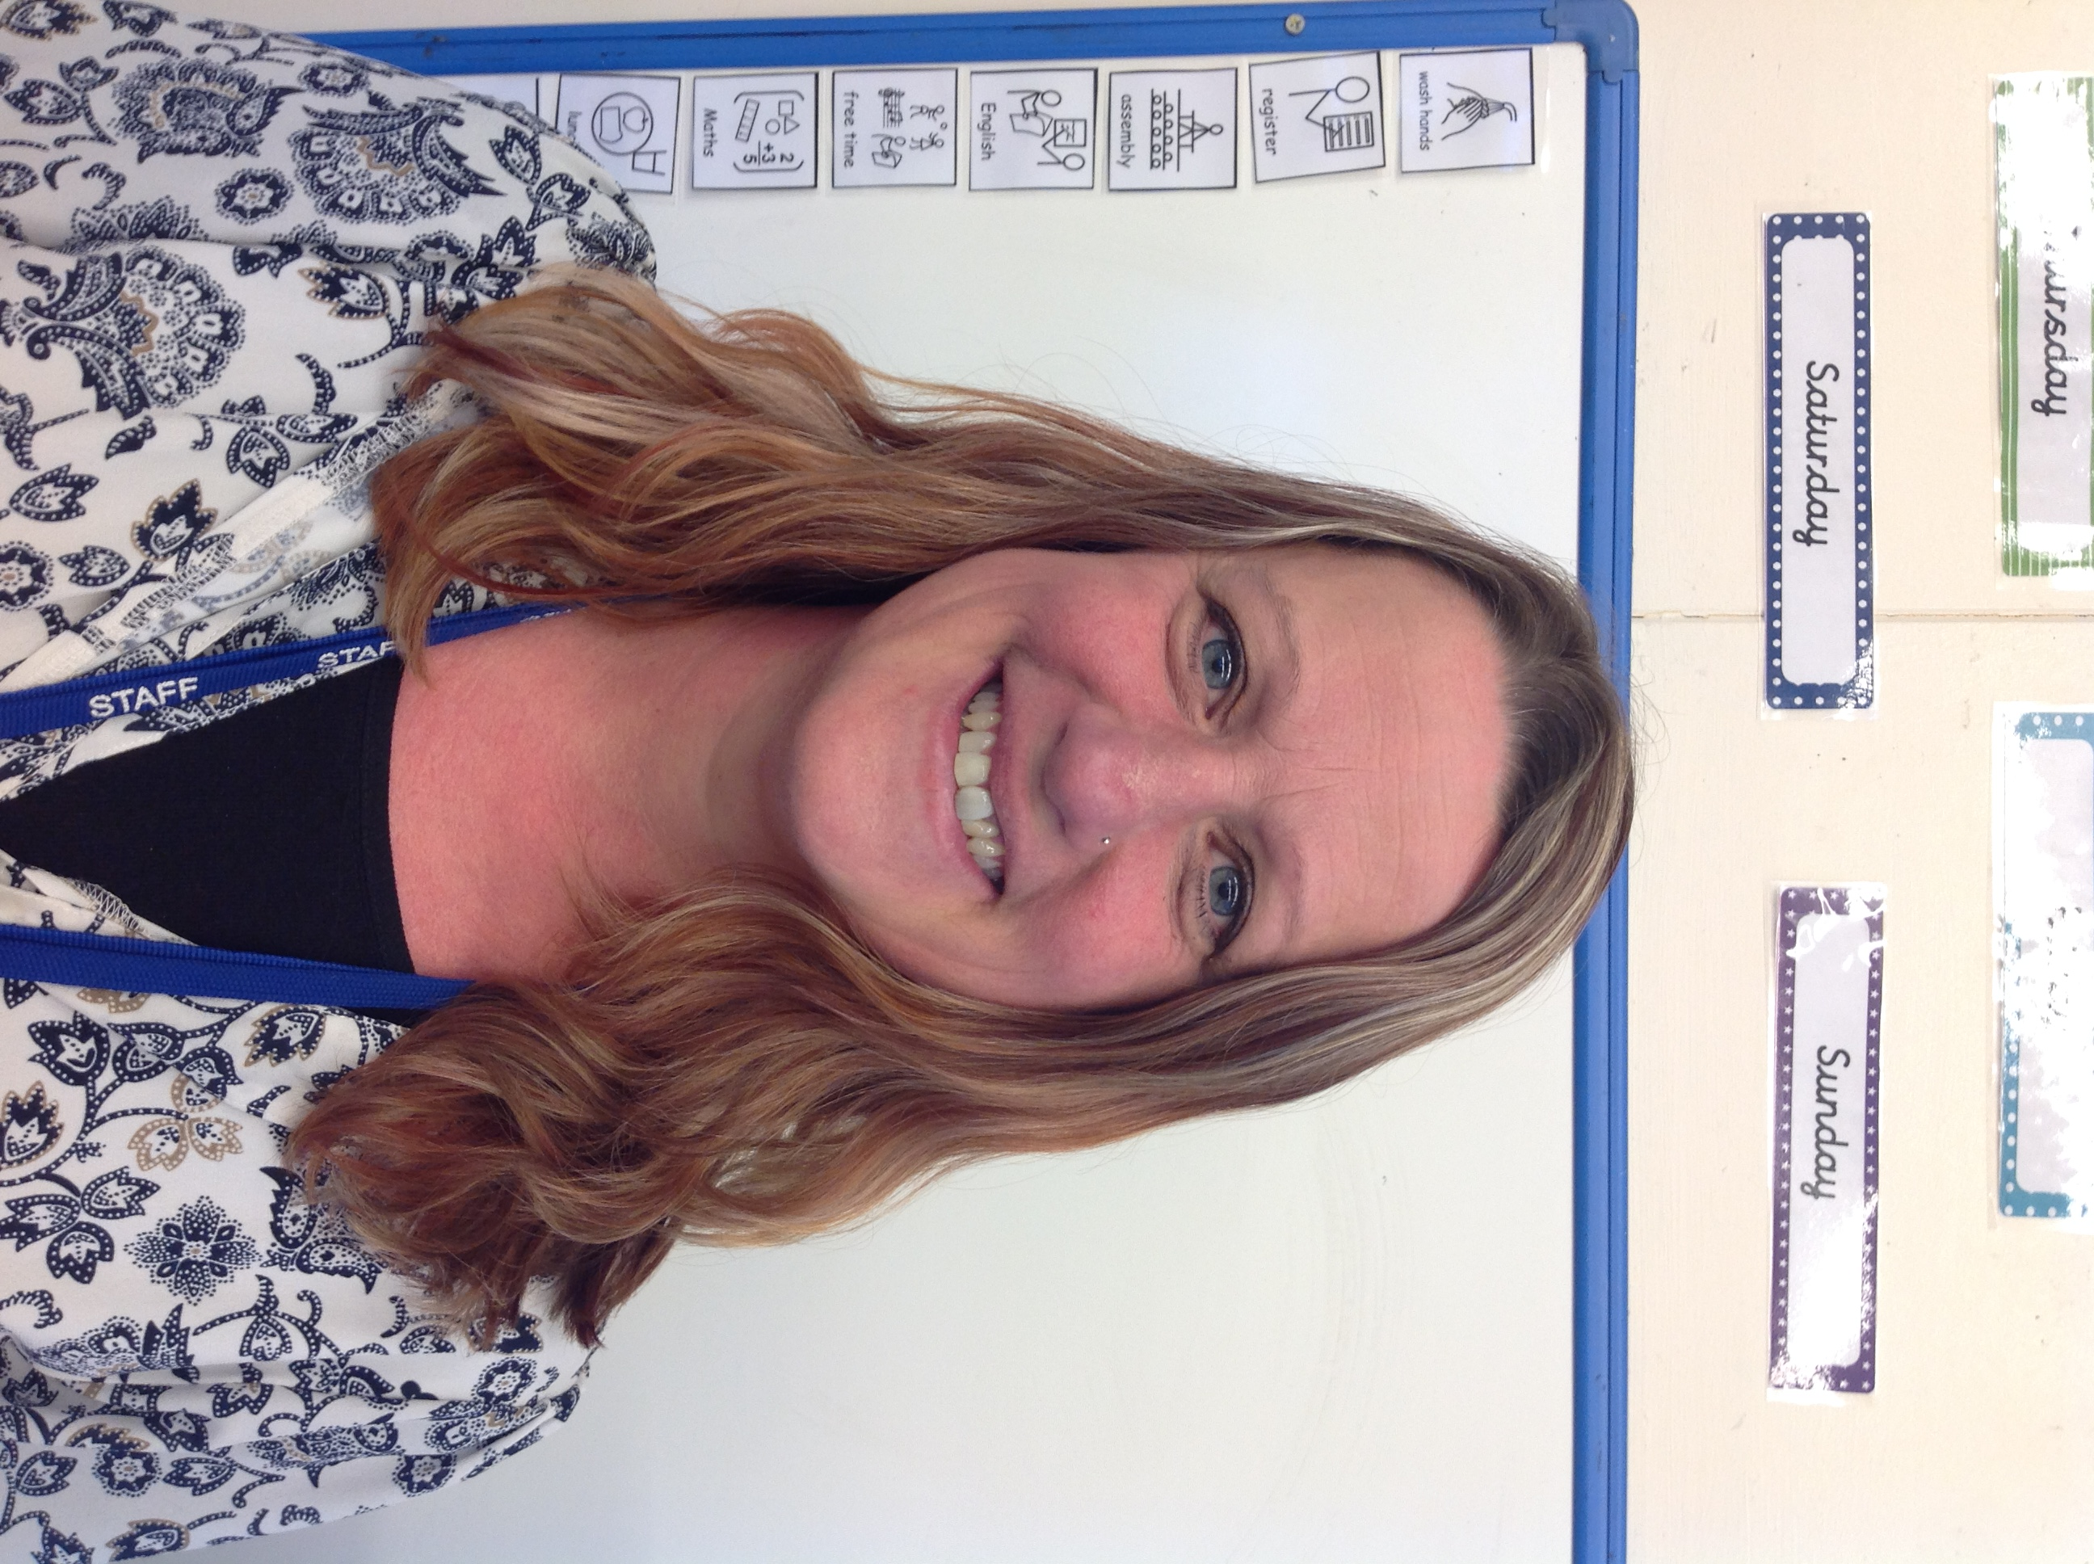
Who might help?
Mrs Montandon (Headteacher/ Deputy Safeguarding Lead)
Laura Haines (Assistant Headteacher/SENDCO/Designated Safeguarding Lead
Mrs Worrall (Assistant Headteacher/Deputy Safeguarding Lead)
Karen Crossland (Early Years Lead/ Early Years Safeguarding Lead)
Sarah Benfield (Family Liaison Officer/Attendance Officer)
Alternatively, you may choose to talk to your child’s Class Teacher.

Slide 5
Key Contact Details School Phone Number: 01527 831885
Mrs Montandon: Office@millfields.worcs.sch.uk
Laura Haines: lo13@millfields.worcs.sch.uk
Mrs Worrall: Office@millfields.worcs.uk
Karen Crossland: Office@millfields.worcs.sch.uk
Sarah Benfield: Office@millfields.worcs.sch.uk
Class email addresses: (Class Name)@millfields.worcs.sch.uk

Slide 6
How might we help? We will support you as a family in any way we can. This might include:
Providing time for you to talk and us to listen to your worries
Providing or recommending key interventions
Providing targeted support
Helping you find the right outside agencies
Filling out an Early Help Support assessment with you
Helping you complete referrals to support services
Supporting you with concerns over attendance

Slide 7
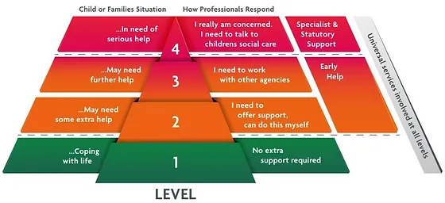
Early Help Early Help is a pathway to supporting your child and you during a challenging time.
The diagram below shows the range of needs at different levels. We use this diagram to make sure we provide the best support for different families’ individual situations.

Slide 8
Support at school (Level 1)
All staff are Trauma Informed Schools Trained
We have a Senior Mental Health Lead
A member of the Senior Leadership Team is available on the door before school
Class Teachers are available on the door after school
Appointments can be booked to speak to Class Teachers
Class email addresses to email the teacher directly
Class Information Evenings
Termly parents evenings
Parent App for information sharing
Forest School
Attendance monitoring
Stars of the week
Newsletters
Curriculum Evenings
Forest School
School Councillors
All staff trained in Safeguarding including Prevent, FGM and Online Safety.
All DSL’s trained in CSE
Online Safety Curriculum
Online Safety Parent Information Evening
PSHE lessons-Jigsaw scheme
Zone of Regulation check ins

Slide 9
Support at school (Level 2)
Interventions targeted to meet the needs of specific children including social and emotional needs
Individual Provision Maps or Pastoral Support Plans in place
Parental Meetings to discuss targets
Morning Meet and Greet available
Access to the Sensory Rooms
Lunch Club
Advice from SENDCO
Advice from Designated Senior Lead
Sharing of Individual Targets and Reviews
Liaison with the Attendance Officer
Liaison with the Family Support
Office
Home/School Communication books
Bespoke reward systems
Access to Nurture groups
Targeted parental workshops
Sign posting to external supports

Slide 10
Support at school (Level 3)
Assessment and Advice from Outside Agencies:
Speech and Language Therapy
Educational Psychologist- Dr Anita Soni
School Nursing Team-Offer support and advice e.g. diet, toileting
Behaviour support from Specialists at the PRU
Support from Complex Communication Team
Area SENDCO
Sensory Impairment Team
Possible referrals to:
Early Intervention Family Support/Targeted Family Support
Starting Well
Umbrella Pathway
Reach 4 Well being
CAHMS
Community Paediatrician
Children’s Occupational Therapy

Slide 11
Fourth Level of Support
If a member of staff, parent/carer or member of the public thinks a child or young person is at immediate risk of significant harm they should contact the Family Front Door (FFD) – 01905 822 666 or in an emergency always call 999.

Slide 12
Additional information about Safeguarding
We are committed to safeguarding and promoting the welfare of children and expects all staff and volunteers to share this commitment.
We ensure that everyone working in our school has the necessary checks completed to enable them to work with children and that they are regularly trained to deal with issues around child protection and safeguarding.
We have staff members and governors who are specifically trained and nominated within the school.
We have policies and procedures in place that contribute to our safeguarding commitment, including our Safeguarding Policy which can be viewed below. Please take the time to read our policies and do not hesitate to contact the school should you have any questions.
We follow the Worcestershire Safeguarding Children’s Partnership guidance and have systems in place to share concerns regarding children’s welfare with our Designated Safeguarding Leads, with parents and with relevant external agencies.
We actively support the Government's Prevent agenda, to counter radicalism and extremism.
All staff have received PREVENT training on how to identify the early stages of radicalisation and what to do.
All staff have been trained to identify early cases of child sexual exploitation. At school, we use the CSE Screening tool if we have concerns.
All staff have received training on FGM (Female Genital Mutilation). Staff know how to identify if a child may be at risk. They know the signs to look for and most importantly how to refer.

